Slide 1

A
B
C
D
E
Introduction to Telescopes
What is a telescope?
Purpose and basic components.
Example of how telescopes magnify distant objects.
Working of Telescopes
How the objective and eyepiece function.
Magnifying power and its formula.
Example calculation for magnifying power.
Terrestrial vs Astronomical Telescopes
Terrestrial Telescopes
Astronomical Telescopes
Light-Gathering & Resolving Power
Limitations of Refracting Telescopes
Issues with Large Lenses
Chromatic Aberration
Switch to Reflecting Telescopes
Reflecting Telescopes & Examples
Why Reflecting Telescopes?
Cassegrain Telescope
Notable Telescopes

Slide 2

E
A
B
D
C
Terrestrial vs Astronomical Telescopes
Terrestrial Telescopes
Astronomical Telescopes
Light-Gathering & Resolving Power
Limitations of Refracting Telescopes
Issues with Large Lenses
Chromatic Aberration
Switch to Reflecting Telescopes
Working of Telescopes
How the objective and eyepiece function.
Magnifying power and its formula.
Example calculation for magnifying power.
Reflecting Telescopes & Examples
Why Reflecting Telescopes?
Cassegrain Telescope
Notable Telescopes
Introduction to Telescopes
What is a telescope?
Purpose and basic components.
Example of how telescopes magnify distant objects.
Introduction to Telescopes

Slide 3
E
A
B
D
C
Introduction to Telescopes
Terrestrial vs Astronomical Telescopes
Terrestrial Telescopes
Astronomical Telescopes
Light-Gathering & Resolving Power
Limitations of Refracting Telescopes
Issues with Large Lenses
Chromatic Aberration
Switch to Reflecting Telescopes
Working of Telescopes
How the objective and eyepiece function.
Magnifying power and its formula.
Example calculation for magnifying power.
Reflecting Telescopes & Examples
Why Reflecting Telescopes?
Cassegrain Telescope
Notable Telescopes
Introduction to Telescopes
What is a telescope?
Purpose and basic components.
Example of how telescopes magnify distant objects.

Slide 4
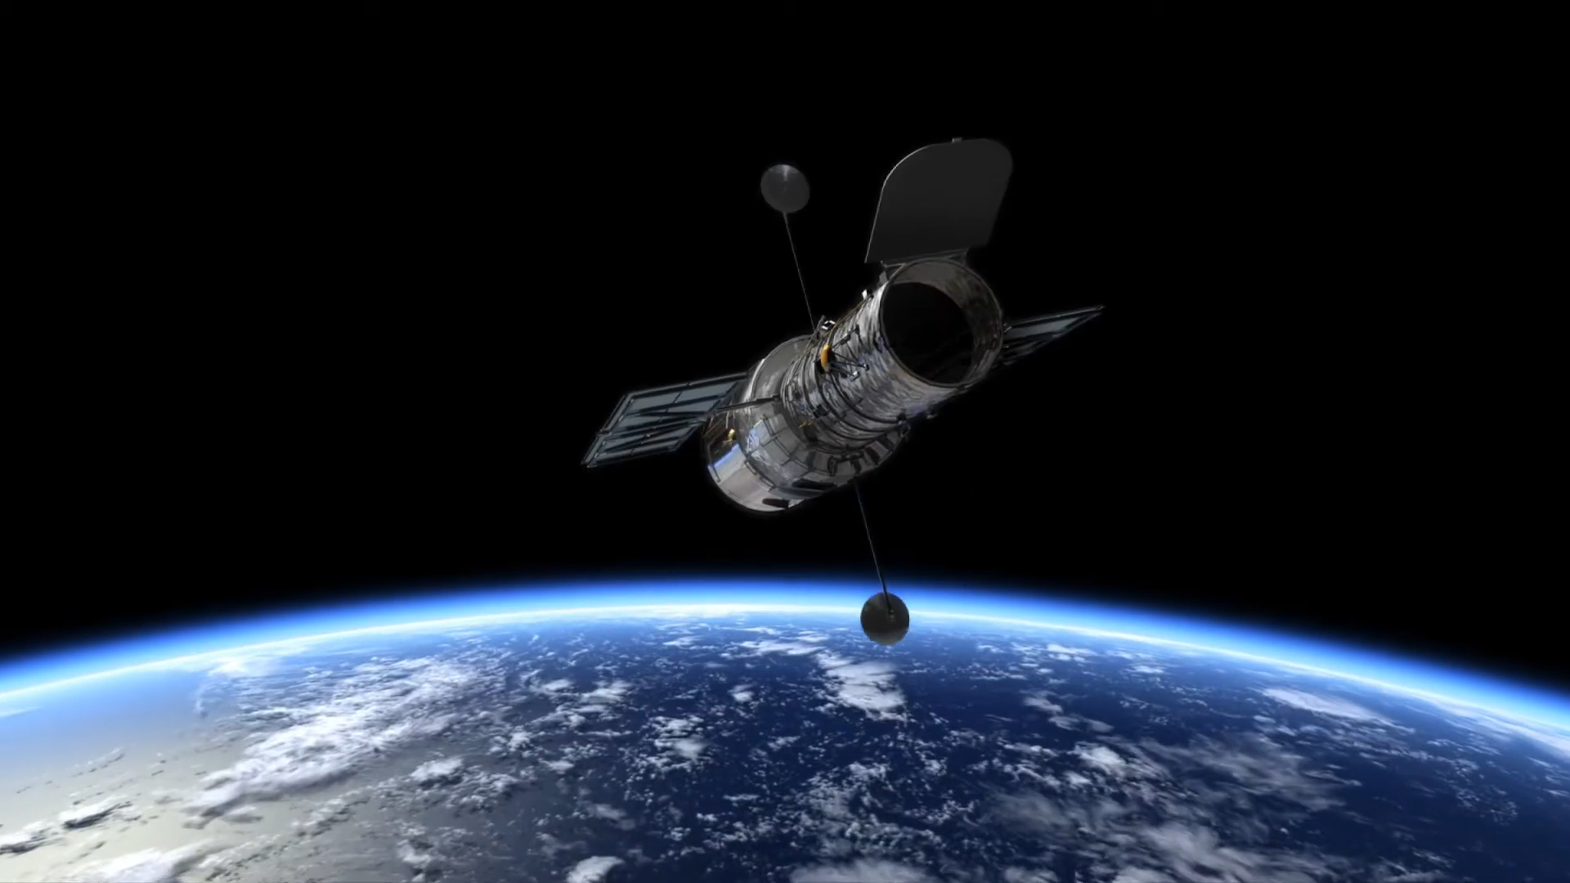
E
A
B
D
C
Introduction to Telescopes
Terrestrial vs Astronomical Telescopes
Terrestrial Telescopes
Astronomical Telescopes
Light-Gathering & Resolving Power
Limitations of Refracting Telescopes
Issues with Large Lenses
Chromatic Aberration
Switch to Reflecting Telescopes
Working of Telescopes
How the objective and eyepiece function.
Magnifying power and its formula.
Example calculation for magnifying power.
Reflecting Telescopes & Examples
Why Reflecting Telescopes?
Cassegrain Telescope
Notable Telescopes
Introduction to Telescopes
What is a telescope?
Purpose and basic components.
Example of how telescopes magnify distant objects.
- Hubble Space Telescope Over the Earth

Slide 5
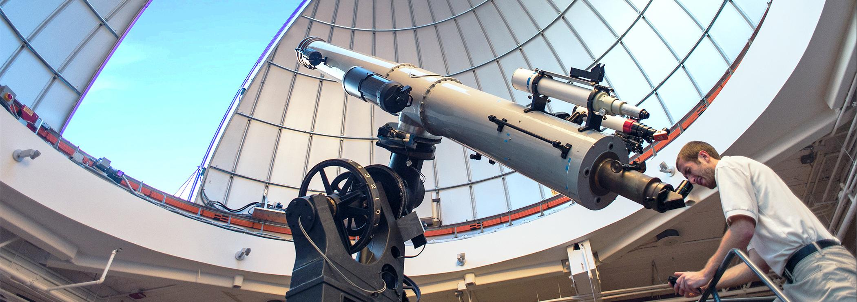
E
A
B
D
C
Introduction to Telescopes
What is a Telescope ?
A device designed to magnify distant objects.
Widely used in astronomy to study celestial objects
and in terrestrial observations.
Terrestrial vs Astronomical Telescopes
Terrestrial Telescopes
Astronomical Telescopes
Light-Gathering & Resolving Power
Limitations of Refracting Telescopes
Issues with Large Lenses
Chromatic Aberration
Switch to Reflecting Telescopes
Working of Telescopes
How the objective and eyepiece function.
Magnifying power and its formula.
Example calculation for magnifying power.
Reflecting Telescopes & Examples
Why Reflecting Telescopes?
Cassegrain Telescope
Notable Telescopes
Introduction to Telescopes
What is a telescope?
Purpose and basic components.
Example of how telescopes magnify distant objects.

Slide 6
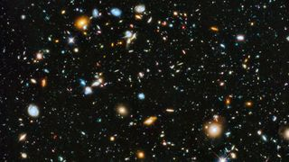
E
A
B
D
C
Introduction to Telescopes
What Does a Telescope Do?
Magnifies distant objects, making them appear closer and clearer.
Used in astronomy to observe celestial objects and in terrestrial applications like wildlife spotting.
Terrestrial vs Astronomical Telescopes
Terrestrial Telescopes
Astronomical Telescopes
Light-Gathering & Resolving Power
Limitations of Refracting Telescopes
Issues with Large Lenses
Chromatic Aberration
Switch to Reflecting Telescopes
Working of Telescopes
How the objective and eyepiece function.
Magnifying power and its formula.
Example calculation for magnifying power.
Reflecting Telescopes & Examples
Why Reflecting Telescopes?
Cassegrain Telescope
Notable Telescopes
Introduction to Telescopes
What is a telescope?
Purpose and basic components.
Example of how telescopes magnify distant objects.
Introduction
Hubble Ultra Deep Field:
One of the Hubble Telescope's most iconic images, capturing about 10,000 galaxies up to 10 billion light-years away. Released in 2014, this improved composite reveals the universe's origins using advanced imaging technology.

Slide 7
E
A
B
D
C
Introduction to Telescopes
Introduction
What Does a Telescope Do?
Magnifies distant objects, making them appear closer and clearer.
Used in astronomy to observe celestial objects and in terrestrial applications like wildlife spotting.
Terrestrial vs Astronomical Telescopes
Terrestrial Telescopes
Astronomical Telescopes
Light-Gathering & Resolving Power
Limitations of Refracting Telescopes
Issues with Large Lenses
Chromatic Aberration
Switch to Reflecting Telescopes
Working of Telescopes
How the objective and eyepiece function.
Magnifying power and its formula.
Example calculation for magnifying power.
Reflecting Telescopes & Examples
Why Reflecting Telescopes?
Cassegrain Telescope
Notable Telescopes
Introduction to Telescopes
What is a telescope?
Purpose and basic components.
Example of how telescopes magnify distant objects.
Hubble Ultra Deep Field:
One of the Hubble Telescope's most iconic images, capturing about 10,000 galaxies up to 10 billion light-years away. Released in 2014, this improved composite reveals the universe's origins using advanced imaging technology.

Slide 8
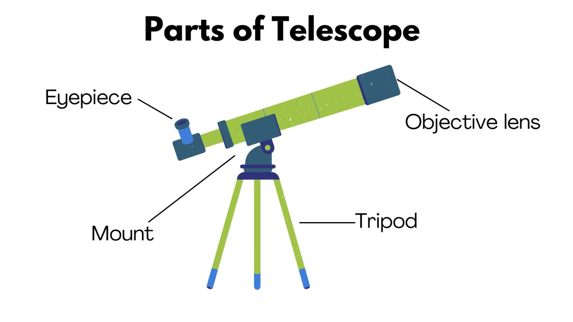
E
A
B
D
C
Introduction to Telescopes
Basic Components
Terrestrial vs Astronomical Telescopes
Terrestrial Telescopes
Astronomical Telescopes
Light-Gathering & Resolving Power
Limitations of Refracting Telescopes
Issues with Large Lenses
Chromatic Aberration
Switch to Reflecting Telescopes
Working of Telescopes
How the objective and eyepiece function.
Magnifying power and its formula.
Example calculation for magnifying power.
Reflecting Telescopes & Examples
Why Reflecting Telescopes?
Cassegrain Telescope
Notable Telescopes
Introduction to Telescopes
What is a telescope?
Purpose and basic components.
Example of how telescopes magnify distant objects.
1. Objective Lens/Mirror:
Collects light and forms a real image.
Larger aperture improves light-gathering ability.
2. Eyepiece Lens:
Magnifies the image created by the objective lens.
Provides the final magnified view for observation.

Slide 9
E
A
B
D
C
Introduction to Telescopes
Basic Components
1. Objective Lens/Mirror:
Collects light and forms a real image.
Larger aperture improves light-gathering ability.
2. Eyepiece Lens:
Magnifies the image created by the objective lens.
Provides the final magnified view for observation.
Terrestrial vs Astronomical Telescopes
Terrestrial Telescopes
Astronomical Telescopes
Light-Gathering & Resolving Power
Limitations of Refracting Telescopes
Issues with Large Lenses
Chromatic Aberration
Switch to Reflecting Telescopes
Working of Telescopes
How the objective and eyepiece function.
Magnifying power and its formula.
Example calculation for magnifying power.
Reflecting Telescopes & Examples
Why Reflecting Telescopes?
Cassegrain Telescope
Notable Telescopes
Introduction to Telescopes
What is a telescope?
Purpose and basic components.
Example of how telescopes magnify distant objects.

Slide 10
E
A
B
D
C
Terrestrial vs Astronomical Telescopes
Terrestrial Telescopes
Astronomical Telescopes
Light-Gathering & Resolving Power
Limitations of Refracting Telescopes
Issues with Large Lenses
Chromatic Aberration
Switch to Reflecting Telescopes
Working of Telescopes
How the objective and eyepiece function.
Magnifying power and its formula.
Example calculation for magnifying power.
Reflecting Telescopes & Examples
Why Reflecting Telescopes?
Cassegrain Telescope
Notable Telescopes
Introduction to Telescopes
What is a telescope?
Purpose and basic components.
Example of how telescopes magnify distant objects.
Introduction to Telescopes

Slide 11
E
A
B
D
C
Terrestrial vs Astronomical Telescopes
Terrestrial Telescopes
Astronomical Telescopes
Light-Gathering & Resolving Power
Limitations of Refracting Telescopes
Issues with Large Lenses
Chromatic Aberration
Switch to Reflecting Telescopes
Working of Telescopes
How the objective and eyepiece function.
Magnifying power and its formula.
Example calculation for magnifying power.
Reflecting Telescopes & Examples
Why Reflecting Telescopes?
Cassegrain Telescope
Notable Telescopes
Introduction to Telescopes
What is a telescope?
Purpose and basic components.
Example of how telescopes magnify distant objects.
Working of Telescopes

Slide 12
E
Working of Telescopes
B
D
C
Objective Lens/Mirror
Captures light from a distant object.
Forms a real, inverted image inside the telescope tube.
Larger aperture allows gathering more light, making distant objects brighter.
Terrestrial vs Astronomical Telescopes
Terrestrial Telescopes
Astronomical Telescopes
Light-Gathering & Resolving Power
Limitations of Refracting Telescopes
Issues with Large Lenses
Chromatic Aberration
Switch to Reflecting Telescopes
Working of Telescopes
How the objective and eyepiece function.
Magnifying power and its formula.
Example calculation for magnifying power.
Reflecting Telescopes & Examples
Why Reflecting Telescopes?
Cassegrain Telescope
Notable Telescopes
Eyepiece Lens
Magnifies the real image formed by the objective lens.
Allows the observer to see a clearer, magnified view.

Slide 13

E
Working of Telescopes
B
D
C
Magnifying Power & Example Calculation
The ratio of the angular size of the image to the angular size of the object.
Formula: 𝑚 = $\frac{fo}{fe}$
where 𝑓𝑜 is the focal length of the objective and 𝑓𝑒 is the focal length of the eyepiece.
Terrestrial vs Astronomical Telescopes
Terrestrial Telescopes
Astronomical Telescopes
Light-Gathering & Resolving Power
Limitations of Refracting Telescopes
Issues with Large Lenses
Chromatic Aberration
Switch to Reflecting Telescopes
Working of Telescopes
How the objective and eyepiece function.
Magnifying power and its formula.
Example calculation for magnifying power.
Reflecting Telescopes & Examples
Why Reflecting Telescopes?
Cassegrain Telescope
Notable Telescopes

Slide 14
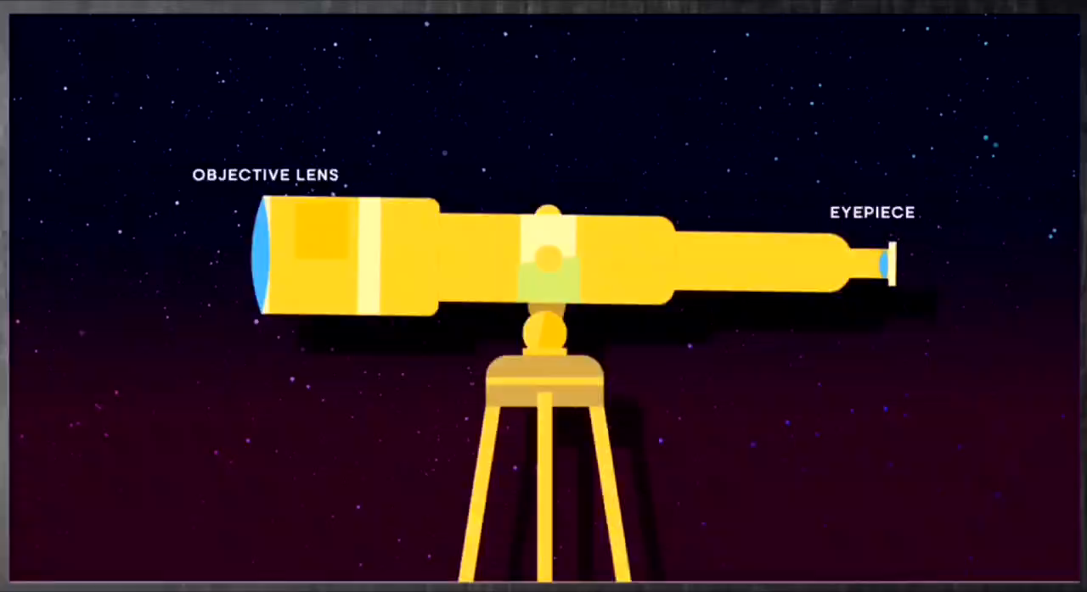
E
Working of Telescopes
B
D
C
Terrestrial vs Astronomical Telescopes
Terrestrial Telescopes
Astronomical Telescopes
Light-Gathering & Resolving Power
Limitations of Refracting Telescopes
Issues with Large Lenses
Chromatic Aberration
Switch to Reflecting Telescopes
Working of Telescopes
How the objective and eyepiece function.
Magnifying power and its formula.
Example calculation for magnifying power.
Reflecting Telescopes & Examples
Why Reflecting Telescopes?
Cassegrain Telescope
Notable Telescopes

Slide 15
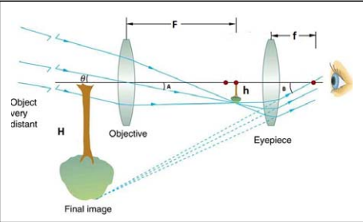
E
Working of Telescopes
B
D
C
Terrestrial vs Astronomical Telescopes
Terrestrial Telescopes
Astronomical Telescopes
Light-Gathering & Resolving Power
Limitations of Refracting Telescopes
Issues with Large Lenses
Chromatic Aberration
Switch to Reflecting Telescopes
Working of Telescopes
How the objective and eyepiece function.
Magnifying power and its formula.
Example calculation for magnifying power.
Reflecting Telescopes & Examples
Why Reflecting Telescopes?
Cassegrain Telescope
Notable Telescopes

Slide 16

E
Working of Telescopes
B
D
C
Q) A telescope has an objective focal length of 100 cm and
an eyepiece focal length of 1 cm. What is its magnifying
power?
Terrestrial vs Astronomical Telescopes
Terrestrial Telescopes
Astronomical Telescopes
Light-Gathering & Resolving Power
Limitations of Refracting Telescopes
Issues with Large Lenses
Chromatic Aberration
Switch to Reflecting Telescopes
Working of Telescopes
How the objective and eyepiece function.
Magnifying power and its formula.
Example calculation for magnifying power.
Reflecting Telescopes & Examples
Why Reflecting Telescopes?
Cassegrain Telescope
Notable Telescopes
Using the formula:
𝑚 = $\frac{\text{fo}}{\text{fe}}$
𝑚= $\frac{100}{1}$
Answer: The telescope magnifies the object 100 times.

Slide 17
E
B
D
C
Terrestrial vs Astronomical Telescopes
Terrestrial Telescopes
Astronomical Telescopes
Light-Gathering & Resolving Power
Limitations of Refracting Telescopes
Issues with Large Lenses
Chromatic Aberration
Switch to Reflecting Telescopes
Working of Telescopes
How the objective and eyepiece function.
Magnifying power and its formula.
Example calculation for magnifying power.
Reflecting Telescopes & Examples
Why Reflecting Telescopes?
Cassegrain Telescope
Notable Telescopes
Working of Telescopes

Slide 18
E
D
B
C
Terrestrial vs Astronomical Telescopes
Terrestrial Telescopes
Astronomical Telescopes
Light-Gathering & Resolving Power
Limitations of Refracting Telescopes
Issues with Large Lenses
Chromatic Aberration
Switch to Reflecting Telescopes
Working of Telescopes
How the objective and eyepiece function.
Magnifying power and its formula.
Example calculation for magnifying power.
Reflecting Telescopes & Examples
Why Reflecting Telescopes?
Cassegrain Telescope
Notable Telescopes
Terrestrial vs Astronomical Telescopes

Slide 19
E
Terrestrial vs Astronomical Telescopes
D
C
Terrestrial Telescopes
Purpose:
Used for viewing objects on Earth.
Ideal for terrestrial observations like landscapes or ships at sea.
Key Feature:
Inverting Lenses:
Additional lenses correct the image orientation, making the final image erect.
Applications:
Navigation, surveillance, and nature observation.
Terrestrial vs Astronomical Telescopes
Terrestrial Telescopes
Astronomical Telescopes
Light-Gathering & Resolving Power
Limitations of Refracting Telescopes
Issues with Large Lenses
Chromatic Aberration
Switch to Reflecting Telescopes
Reflecting Telescopes & Examples
Why Reflecting Telescopes?
Cassegrain Telescope
Notable Telescopes

Slide 20
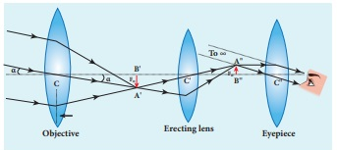
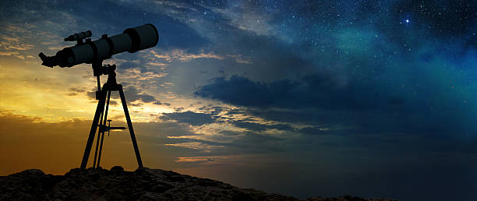
E
Terrestrial vs Astronomical Telescopes
D
C
Terrestrial Telescopes
Terrestrial vs Astronomical Telescopes
Terrestrial Telescopes
Astronomical Telescopes
Light-Gathering & Resolving Power
Limitations of Refracting Telescopes
Issues with Large Lenses
Chromatic Aberration
Switch to Reflecting Telescopes
Reflecting Telescopes & Examples
Why Reflecting Telescopes?
Cassegrain Telescope
Notable Telescopes

Slide 21
E
Terrestrial vs Astronomical Telescopes
D
C
Astronomical Telescopes
Purpose:
Designed for observing celestial objects like stars, planets, and galaxies..
Key Feature:
Light-Gathering Power:
Larger objective lenses or mirrors collect more
light, allowing observation of faint objects.
Resolution:
High resolving power distinguishes objects that appear very close together, revealing details in space.
Terrestrial vs Astronomical Telescopes
Terrestrial Telescopes
Astronomical Telescopes
Light-Gathering & Resolving Power
Limitations of Refracting Telescopes
Issues with Large Lenses
Chromatic Aberration
Switch to Reflecting Telescopes
Reflecting Telescopes & Examples
Why Reflecting Telescopes?
Cassegrain Telescope
Notable Telescopes

Slide 22
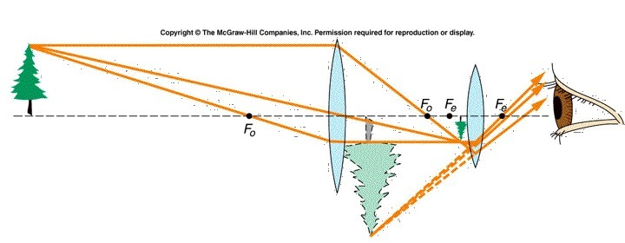
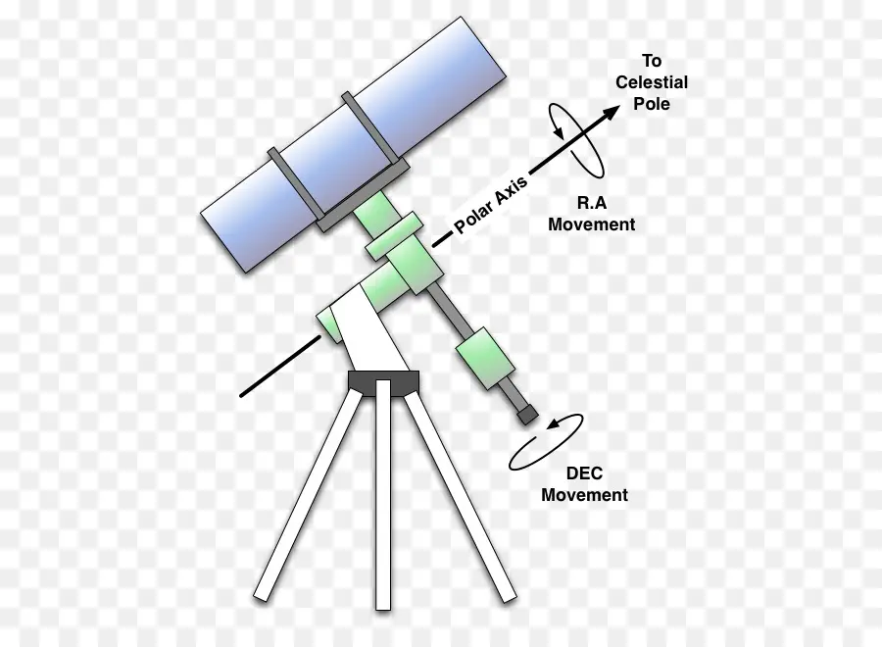
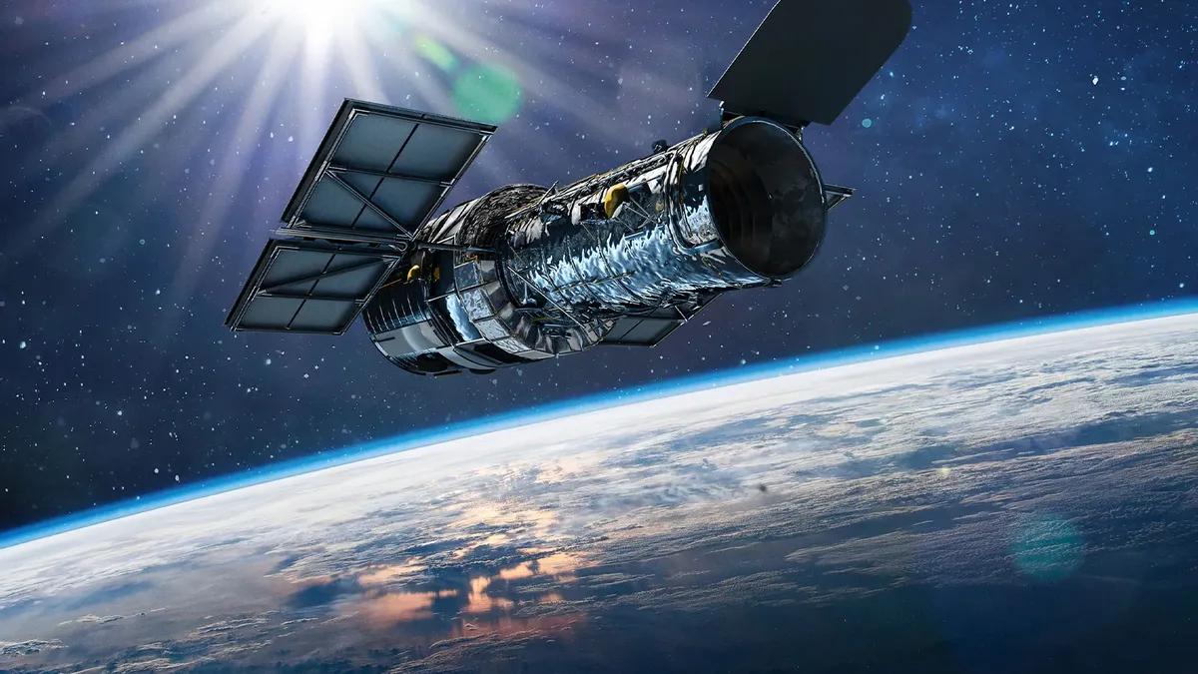
E
Terrestrial vs Astronomical Telescopes
D
C
Astronomical Telescopes
Terrestrial vs Astronomical Telescopes
Terrestrial Telescopes
Astronomical Telescopes
Light-Gathering & Resolving Power
Limitations of Refracting Telescopes
Issues with Large Lenses
Chromatic Aberration
Switch to Reflecting Telescopes
Reflecting Telescopes & Examples
Why Reflecting Telescopes?
Cassegrain Telescope
Notable Telescopes

Slide 23
E
Terrestrial vs Astronomical Telescopes
D
C
Comparison
Terrestrial vs Astronomical Telescopes
Terrestrial Telescopes
Astronomical Telescopes
Light-Gathering & Resolving Power
Limitations of Refracting Telescopes
Issues with Large Lenses
Chromatic Aberration
Switch to Reflecting Telescopes
Reflecting Telescopes & Examples
Why Reflecting Telescopes?
Cassegrain Telescope
Notable Telescopes

Slide 24
E
Terrestrial vs Astronomical Telescopes
D
C
Feature | Terrestrial Telescopes | Astronomical Telescopes
Objective Size | Smaller objectives suitable for Earth-based viewing. | Larger objectives to gather more light for faint celestial objects.
Image Orientation | Produces erect images using additional lenses or prisms. | Produces inverted images; orientation doesn't matter for astronomy.
Primary Use | Observing landscapes, wildlife, and other Earth-based objects. | Observing distant stars, galaxies, and other celestial phenomena.
Light-Gathering Ability | Focused on providing a wide field of view for closer objects. | Maximizes light collection to observe faint and distant objects.
Special Features | Includes features for natural orientation and ease of terrestrial use. | Optimized for high resolution and light capture, often digitally corrected.
Terrestrial vs Astronomical Telescopes
Terrestrial Telescopes
Astronomical Telescopes
Light-Gathering & Resolving Power
Limitations of Refracting Telescopes
Issues with Large Lenses
Chromatic Aberration
Switch to Reflecting Telescopes
Reflecting Telescopes & Examples
Why Reflecting Telescopes?
Cassegrain Telescope
Notable Telescopes

Slide 25
E
D
C
Terrestrial vs Astronomical Telescopes
Terrestrial Telescopes
Astronomical Telescopes
Light-Gathering & Resolving Power
Limitations of Refracting Telescopes
Issues with Large Lenses
Chromatic Aberration
Switch to Reflecting Telescopes
Reflecting Telescopes & Examples
Why Reflecting Telescopes?
Cassegrain Telescope
Notable Telescopes
Terrestrial vs Astronomical
Telescopes

Slide 26
E
D
C
Limitations of Refracting Telescopes
Issues with Large Lenses
Chromatic Aberration
Switch to Reflecting Telescopes
Terrestrial vs Astronomical Telescopes
Terrestrial Telescopes
Astronomical Telescopes
Light-Gathering & Resolving Power
Reflecting Telescopes & Examples
Why Reflecting Telescopes?
Cassegrain Telescope
Notable Telescopes
Limitations of Refracting
Telescopes

Slide 27
E
Limitations of Refracting Telescopes
D
Heavy and Expensive Lenses
Manufacturing and Cost:
Large refracting telescopes require high-quality, expensive lenses. The larger the lens, the higher the cost and difficulty in manufacturing.
Weight Issues:
Larger lenses are heavier and require stronger support structures, increasing cost and complexity.
Structural Challenges:
The precise mounting of large lenses adds engineering challenges, raising the overall telescope cost.
Limitations of Refracting Telescopes
Issues with Large Lenses
Chromatic Aberration
Switch to Reflecting Telescopes
Reflecting Telescopes & Examples
Why Reflecting Telescopes?
Cassegrain Telescope
Notable Telescopes

Slide 28
E
Limitations of Refracting Telescopes
D
Chromatic Aberration
Color Distortion:
Chromatic aberration causes light of different wavelengths to focus at different points, resulting in blurry images with color fringes, especially on bright objects.
Impact on Image Quality:
It reduces clarity, making fine details difficult to discern, particularly with stars and planets.
Solution in Refracting Telescopes:
Special coatings or compound lenses help reduce chromatic aberration but cannot completely eliminate it.
Limitations of Refracting Telescopes
Issues with Large Lenses
Chromatic Aberration
Switch to Reflecting Telescopes
Reflecting Telescopes & Examples
Why Reflecting Telescopes?
Cassegrain Telescope
Notable Telescopes

Slide 29
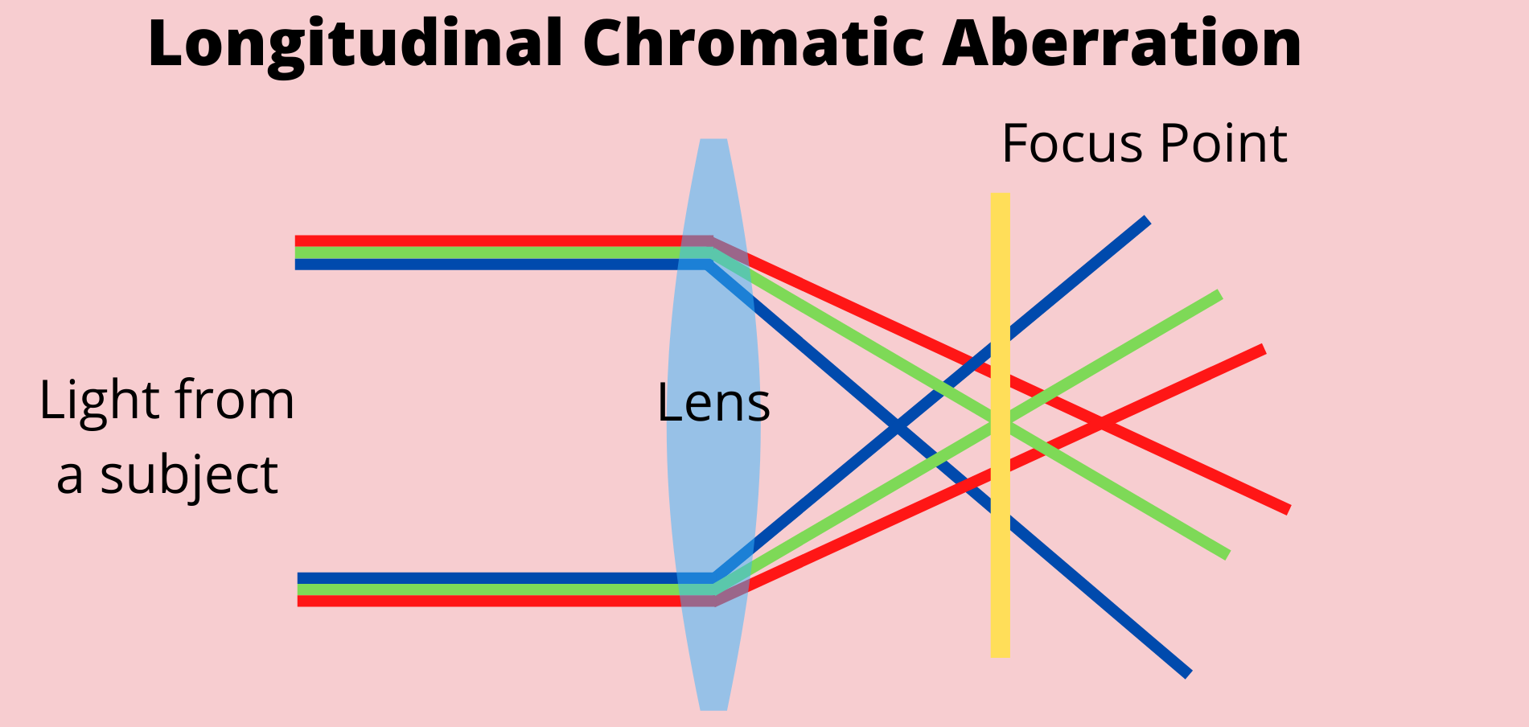
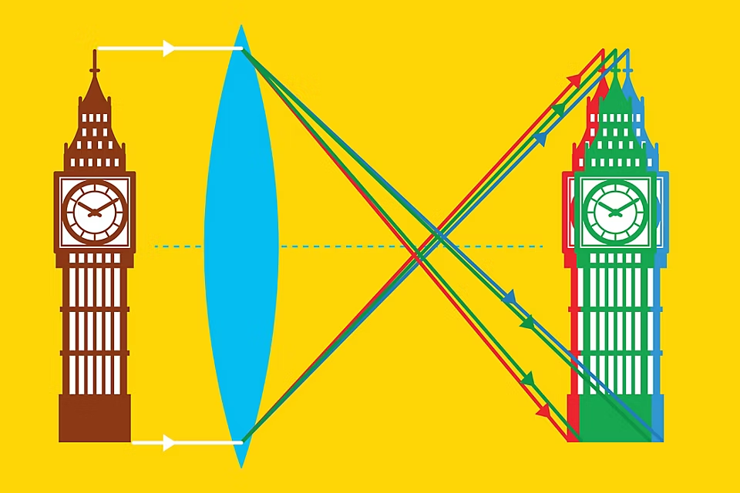
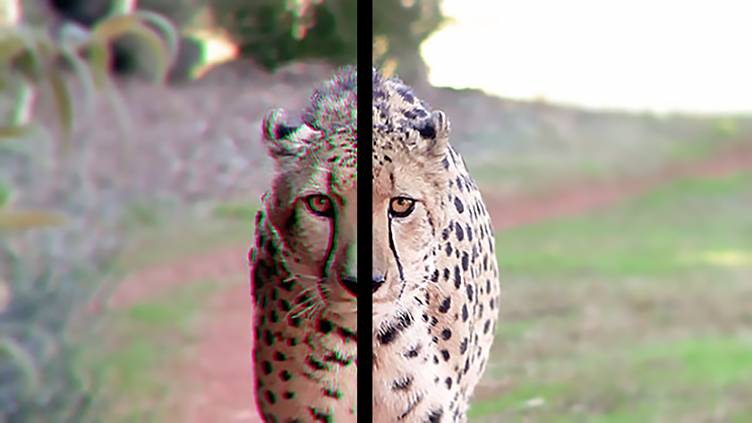
E
Limitations of Refracting Telescopes
D
Chromatic Aberration
Limitations of Refracting Telescopes
Issues with Large Lenses
Chromatic Aberration
Switch to Reflecting Telescopes
Reflecting Telescopes & Examples
Why Reflecting Telescopes?
Cassegrain Telescope
Notable Telescopes

Slide 30
E
Limitations of Refracting Telescopes
D
Mechanical Challenges
Structural Support for Heavy Lenses:
Large refracting telescopes need strong support to prevent lens flexing, which distorts the image.
Deformation and Flexing:
The lens can bend under its weight, causing alignment issues.
Limitations of Refracting Telescopes
Issues with Large Lenses
Chromatic Aberration
Switch to Reflecting Telescopes
Reflecting Telescopes & Examples
Why Reflecting Telescopes?
Cassegrain Telescope
Notable Telescopes

Slide 31
E
Limitations of Refracting Telescopes
D
Mechanical Challenges
Solution in Engineering Challenges:
A precise mounting system is needed to keep the lens stable, adding complexity and cost.
Transition to Reflecting Telescopes:
A precise mounting system is needed to keep the lens stable, adding complexity and cost.
Limitations of Refracting Telescopes
Issues with Large Lenses
Chromatic Aberration
Switch to Reflecting Telescopes
Reflecting Telescopes & Examples
Why Reflecting Telescopes?
Cassegrain Telescope
Notable Telescopes

Slide 32
E
D
Limitations of Refracting Telescopes
Issues with Large Lenses
Chromatic Aberration
Switch to Reflecting Telescopes
Reflecting Telescopes & Examples
Why Reflecting Telescopes?
Cassegrain Telescope
Notable Telescopes
Limitations of Refracting
Telescopes

Slide 33
E
D
Reflecting Telescopes & Examples
Why Reflecting Telescopes?
Cassegrain Telescope
Notable Telescopes
Limitations of Refracting Telescopes
Issues with Large Lenses
Chromatic Aberration
Switch to Reflecting Telescopes
Reflecting Telescopes & Examples

Slide 34
E
Reflecting Telescopes & Examples
Why Reflecting Telescopes?
Introduction:
Reflecting telescopes use mirrors instead of lenses to gather and focus light.
Advantages Over Refracting Telescopes:
No Chromatic Aberration: Mirrors reflect all wavelengths equally.
Larger Size Possible: Mirrors are lighter and easier to support than large lenses.
Lower Cost: Easier to manufacture large mirrors compared to large lenses.
Durability: Mirrors don’t bend under their own weight like lenses.
Reflecting Telescopes & Examples
Why Reflecting Telescopes?
Cassegrain Telescope
Notable Telescopes

Slide 35
E
Reflecting Telescopes & Examples
How Reflecting Telescopes Work
Key Components:
Primary Mirror: Large, concave mirror that gathers and focuses light.
Secondary Mirror: Smaller mirror redirects light to the eyepiece or detector.
Light Path:
Light enters the telescope and strikes the primary mirror.
The mirror focuses light onto the secondary mirror.
The secondary mirror directs the light to the eyepiece or camera for observation.
Reflecting Telescopes & Examples
Why Reflecting Telescopes?
Cassegrain Telescope
Notable Telescopes

Slide 36
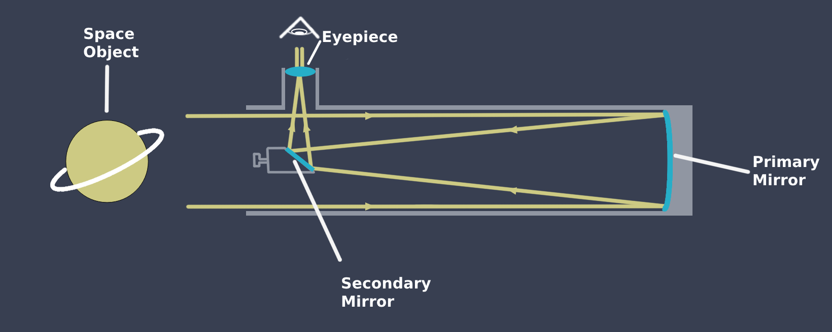
E
Reflecting Telescopes & Examples
How Reflecting Telescopes Work
Advantages of Mirrors:
Reflect light without distortion.
Easy to shape and polish for precision.
Reflecting Telescopes & Examples
Why Reflecting Telescopes?
Cassegrain Telescope
Notable Telescopes

Slide 37
E
Reflecting Telescopes & Examples
Cassegrain Telescope
How It Works:
A type of reflecting telescope.
Uses a parabolic primary mirror and a hyperbolic secondary mirror.
Light is reflected back through a hole in the primary mirror to the eyepiece.
Benefits of Cassegrain Design:
Compact Size: Long focal length in a shorter tube.
Ideal for both astronomical and terrestrial use.
Popular in amateur and professional astronomy.
Reflecting Telescopes & Examples
Why Reflecting Telescopes?
Cassegrain Telescope
Notable Telescopes

Slide 38
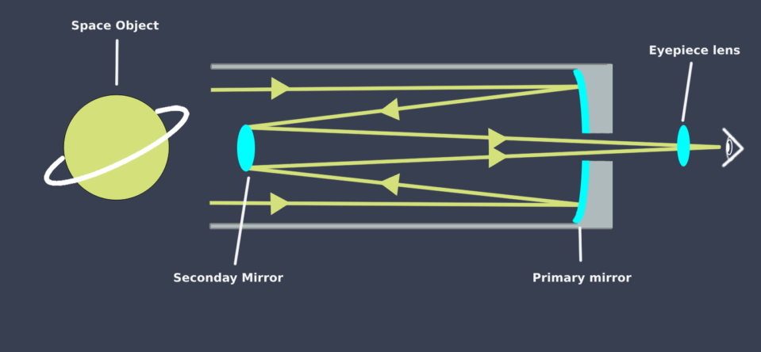
E
Reflecting Telescopes & Examples
Cassegrain Telescope
Reflecting Telescopes & Examples
Why Reflecting Telescopes?
Cassegrain Telescope
Notable Telescopes

Slide 39
E
Reflecting Telescopes & Examples
Cassegrain Telescope
How It Works:
A type of reflecting telescope.
Uses a parabolic primary mirror and a hyperbolic secondary mirror.
Light is reflected back through a hole in the primary mirror to the eyepiece.
Benefits of Cassegrain Design:
Compact Size: Long focal length in a shorter tube.
Ideal for both astronomical and terrestrial use.
Popular in amateur and professional astronomy.
Reflecting Telescopes & Examples
Why Reflecting Telescopes?
Cassegrain Telescope
Notable Telescopes

Slide 40
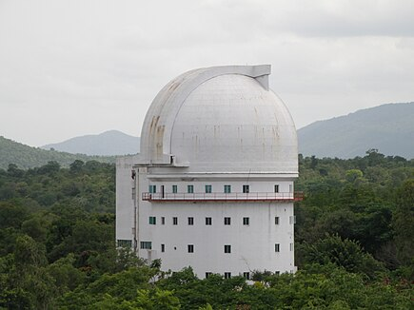
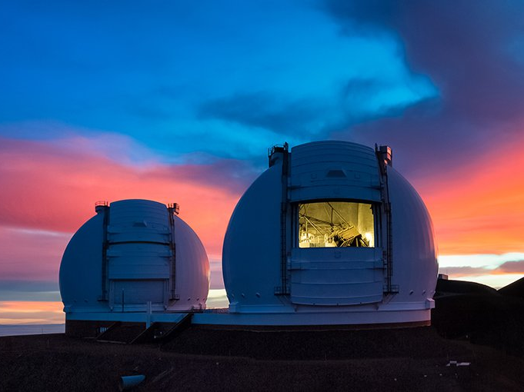
E
Reflecting Telescopes & Examples
Notable Reflecting Telescopes
Reflecting Telescopes & Examples
Why Reflecting Telescopes?
Cassegrain Telescope
Notable Telescopes
Vainu Bappu Observatory (Kavalur, India):
Houses a 2.3-meter reflecting telescope.
Used for studying stars, galaxies, and comets.
Keck Observatory (Hawaii, USA):
Features twin 10-meter reflecting telescopes.
Among the largest optical telescopes in the world.

Slide 41
E
Reflecting Telescopes & Examples
Why Reflecting Telescopes?
Cassegrain Telescope
Notable Telescopes
Reflecting Telescopes & Examples

Slide 42
E
Reflecting Telescopes & Examples
Why Reflecting Telescopes?
Cassegrain Telescope
Notable Telescopes

Slide 43

CREATED BY
Aadhil Nandan
STARRING
Aadhil Nandan
Nezil Rasheed
Abdul Warees
Shakeeb Ahmed
Amarnath P S
TEACHER
Anas Mon
SOURCES
Wikipedia
NCERT Textbook
THANK YOU

